Slide 1


Working from Home
Easy & Simple strategies for Managers to implement now
EDWINA MCCULLOCH
edwina.mcculloch@auridian.com.au
0412 949 088

Slide 2
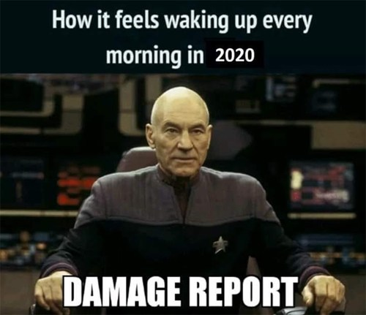
Uncertainty

Slide 3
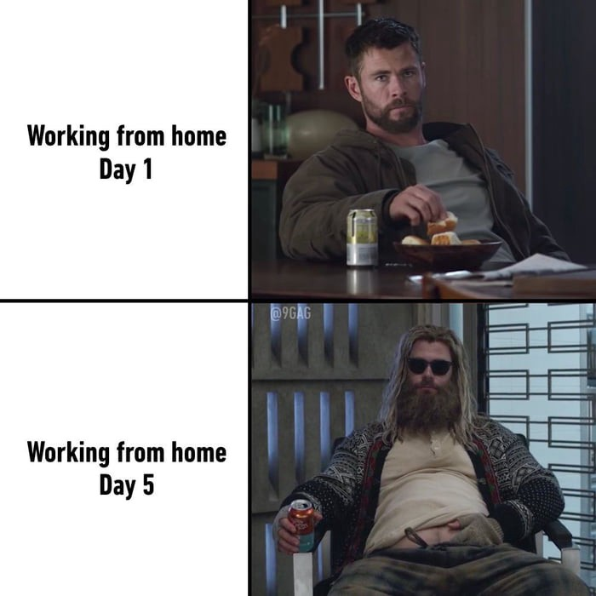

Slide 4
1. Effective Communication

Slide 5
1. Effective Communication
2. Trust

Slide 6
1. Effective Communication
2. Trust
3. Lack of Connection & Loneliness

Slide 7
1. Effective Communication
2. Trust
3. Lack of Connection & Loneliness
4. Distractions at home

Slide 8
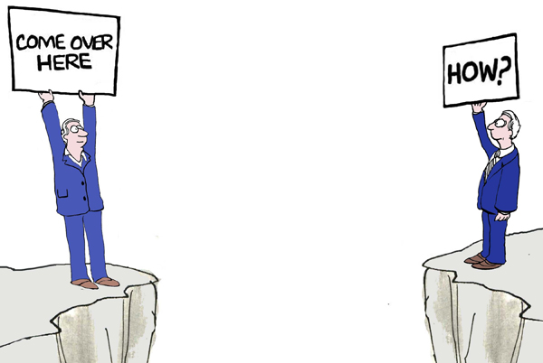
Effective Communication

Slide 9

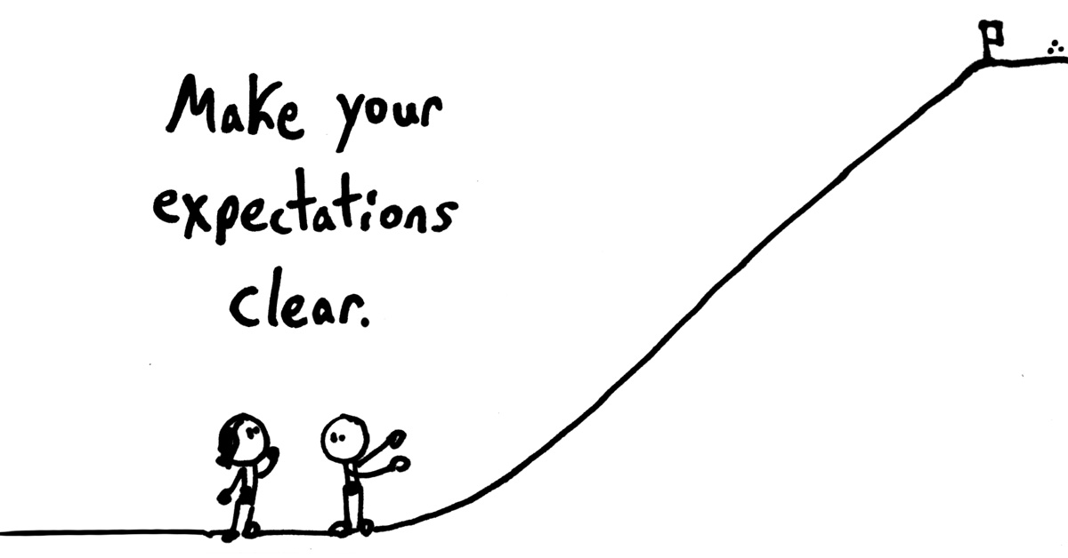
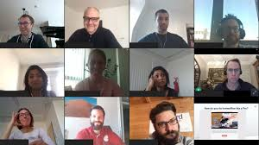
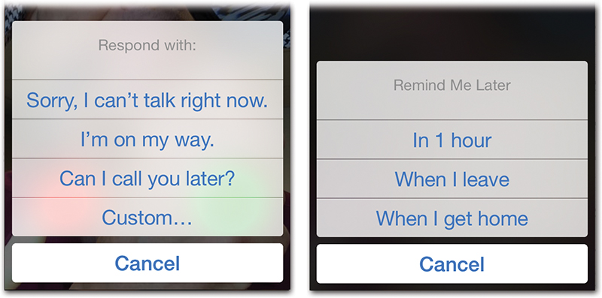

Slide 10

Happy and productive team

Slide 11
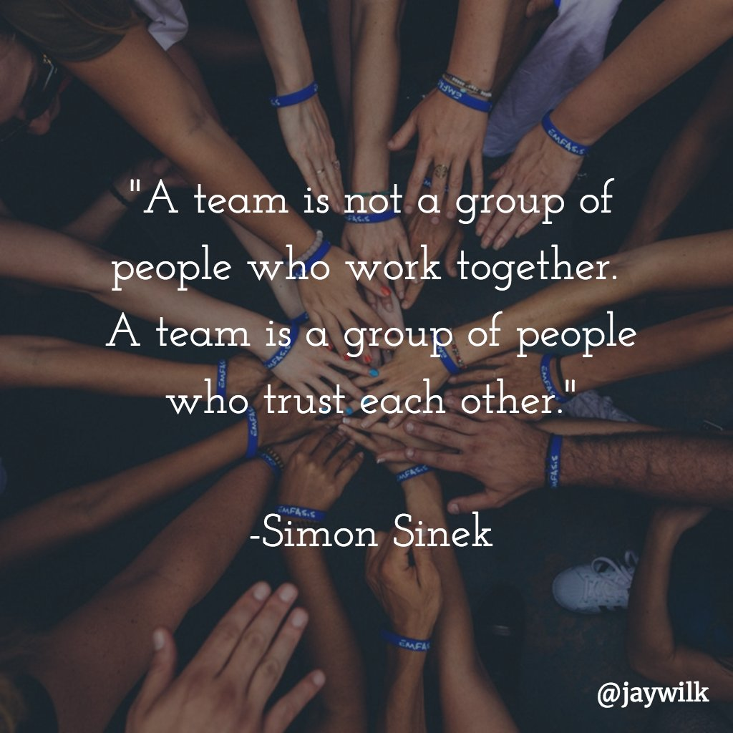
TRUST

Slide 12
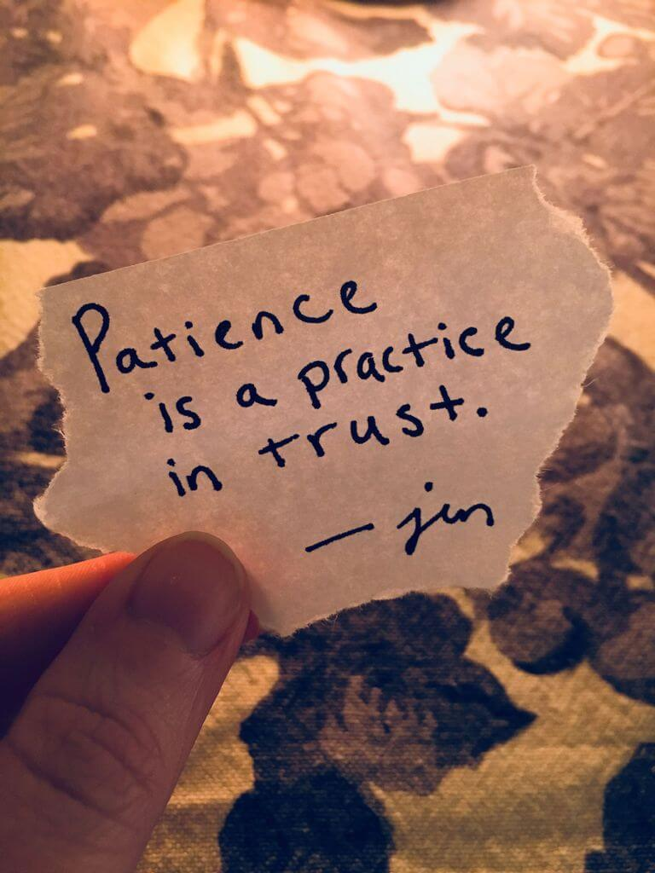


Slide 13
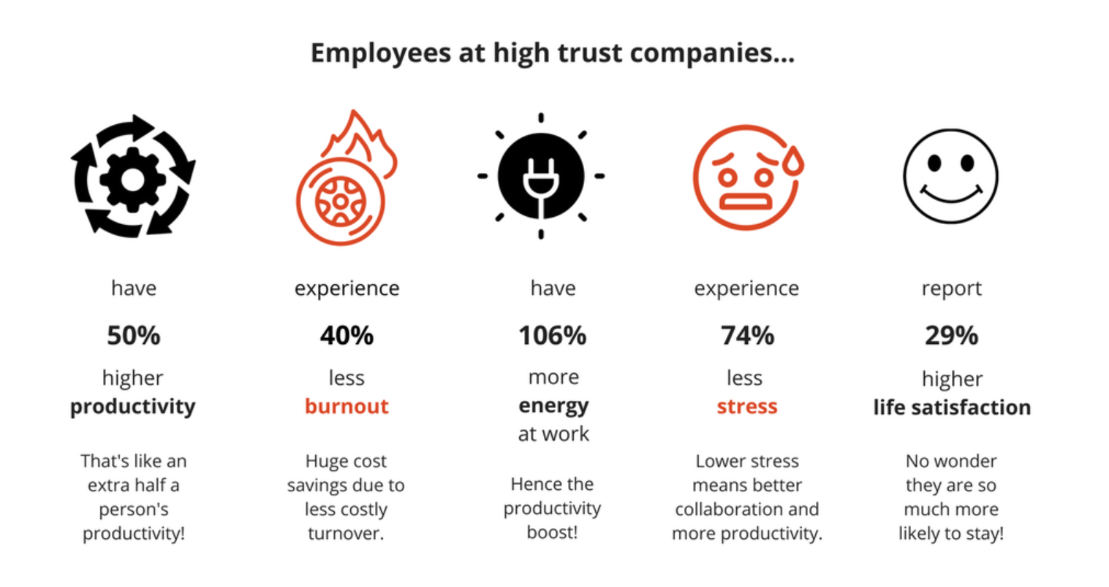
TRUST

Slide 14

Lack of Connection & Loneliness

Slide 15
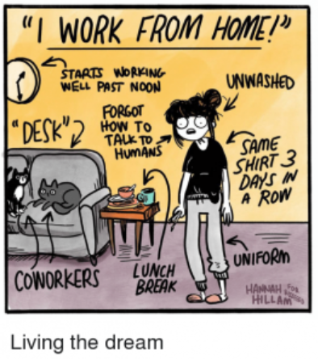
Managing Distractions at Home

Slide 16


Edwina McCulloch
0412 949 088
edwina.mcculloch@auridian.com.au
edwina-mcculloch-529695b9/
www.auridian.com.au

